Slide 1
Analysis of Electric Pump
ThingsGoSocial Internship Application Project Report

Slide 2
3 PHASE SYSTEMS
In electrical engineering, three-phase electric power systems have at least three conductors carrying AC voltages that are offset in time by one-third of the period.
A three-phase system may be arranged in delta (∆) or star (Y)

Slide 3
GIVEN DATA
There is positive correlation between
voltage yb and voltage br , voltage R , voltage Y, voltage B
voltage br and voltage yb , voltage R , voltage Y, voltage B
voltage R and voltage yb , voltage br , voltage Y, voltage B
voltage Y and voltage yb , voltage br , voltage R, voltage B
voltage B and voltage yb , voltage br , voltage R, voltage Y
Three phase star connection phase Voltage and Line voltage have different values Ratio of line to phase voltage is √3 While in delta connection line and phase voltage is same Generally line voltage is 400V and phase voltage is 230V (which we used for residential purpose)

Slide 4
NEW COLUMNS INTRODUCED
Phase Power : average power of system by taking average voltage and current
Instantaneous Power: Power at a particular instance
the instantaneous power,
p = E(1)I(1) + V(2)I(2) + V(3)I(3).

Slide 5
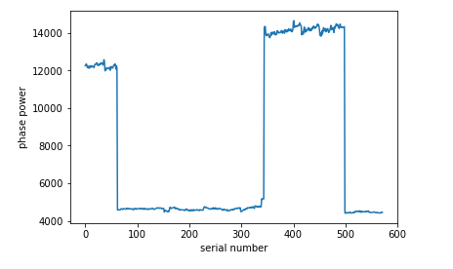
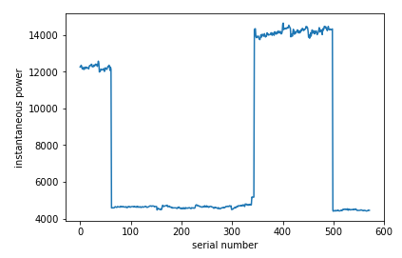
GRAPHS
It can be observed from the above graphs that there was some faults in the
electrical system in dates of serial 60 to 330 and 500 to 580.
Also it can be seen from the given data that the voltages at these points
remain same but the current reduce considerably

Slide 6
ANALYSIS
After observing the data , the analysis is divided into 2 parts-
Clustering
Classification with Principal Component Analysis

Slide 7
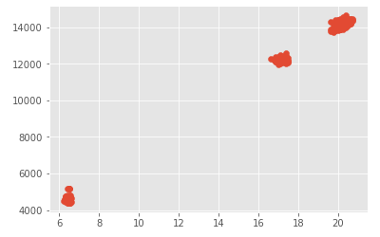
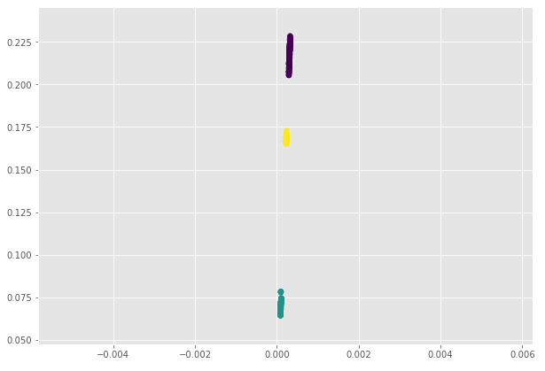
Hierarchical-Agglomerative Clustering
Figure 1- scatter plot
Figure 2- Agglomerative clustering on instantaneous power
There are 3 clusters

Slide 8
Principal Component Analysis
Principal component analysis (PCA) is a statistical procedure that uses an orthogonal transformation
It converts a set of observations of possibly correlated variables (entities each of which takes on various numerical values) into a set of values of linearly uncorrelated variables called principal components.
It is used on this dataset to avoid the curse of dimensionality that is Reduce dimensions without losing information

Slide 9
Predictions
Each machine learning algorithms was performed on the PCA transformed data and following results were obtained where we predicted the Wh(encoded) using the rest of features in dataset
Model name= random forest
Number of errors= 8
Accuracy Score : 0.986013986013986
Model name= decision tree
Number of errors= 8
Accuracy Score : 0.986013986013986
Model name= support vector machine
Number of errors= 8
Accuracy Score : 0.986013986013986

Slide 10
FUTURE SCOPE
More Data points could be used for better results
Discriminate Component Analysis (DCA) could also be performed
More machine learning models could be used to check for better accuracy
Date-Time series Analysis could be performed on the given dataset

Slide 11
THANK YOU
PRESENTATION BY-
SAATWIK BISARIA
B.TECH IT
BVCOE

